Slide 1



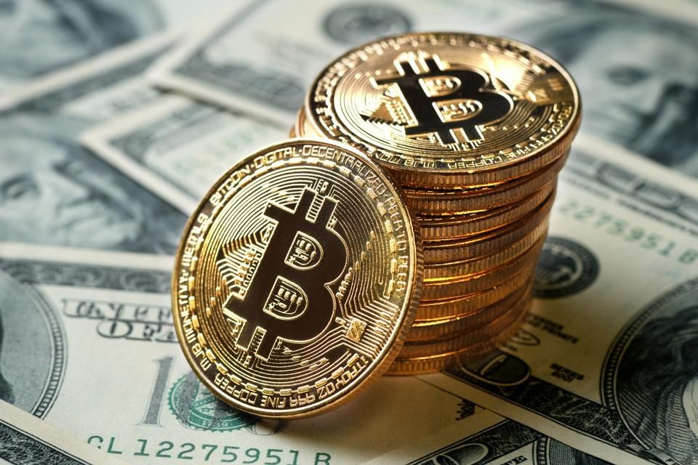
I ntroduction to coding [ET4018]
05/12/2020
Block Chain Project
Course Instructor: Professor MARIN Andrea Task: A nalysis of BTC transactions in block 657354 Group Name: Python Beginners
Members | Full Name | Matricula
1. | OYINKANSOLA O. AKOMOLAFE | 882716
2. | MOHAMED ALIE KAMARA | 877211
Final Analysis Report of block 657354:
The block 657354 has a total total of 1697 transactions and it belongs to the miner called F2Pool with size: 1201057 bytes,
Nonce: 3753965195, transaction volume: $22299985.06, block reward: $119081.38, fee reward: $1446.10.
The maximum:
amount of money moved in this block is$8210521.24 by the user address: 3BBcr1ps4h8yX7U6wdbkdnks3NPJoeeLq7 to the
following adresses; 33DxxXyh3nLYgYB1sM8VTPb7bipkonuhB4,3DRdYoNeVrAYVDcN7rTTekfwT8K644Uwj7. A total of $8,017,633.06 was sent to 3DRdYoNeVrAYVDcN7rTTekfwT8K644Uwj7 and $190335.10 was sent to 33DxxXyh3nLYgYB1sM8VTPb7bipkonuhB4 with a fee of fee $0.13(2.694 sat/B - 1.009 sat/WU - 248 bytes).
While the minimum:
amount of money moved is $0.10 by 1HpZ5uLZLufGnyYGhoMqdqZVs to 1iTVsng7KppctQG8Vw9ojyJu
with the hash f5d0a2be813539737145307fbbc47b14d551f5b046df2078e00708c62ec7de55 another input of $443,24 was also made by 1CCDaL5gCiYQjxPi7vpnDRVLHYEiw2rqJ8 and sent to the same address making the total amount of money transacted with this hash as $439,10 but a total fee of $4,87 (63.638 sat/B - 15.909 sat/WU - 403 bytes)

Slide 2
05/12/2020
was paid for both transactions in this hash.
Block Chain Project
And the average:
amount of money moved within the block is $11,042.84.
Summary Table:
A summary table of block 657354 including the transaction numbers of the maximum and minimum value of dollars transacted, also indicating the hashes for further confirmation and the addresses of both the sender, receiver and the fee for both the maximum and minimum value. :
Transaction No. | Hash
115 | f5d0a2be813539737145307fbbc47b14d551f5b046df2078e00708c62ec7de55
1373 | a60d87388f658ee8f6f371ed6fff6f810bd12c31304f6b4f020f80a4e70b7061
Transaction No. 115 1373 | Input_addrs Output_addrs
 | 1HpZ5uLZLufGnyYGhoMqdqZVsQRFghvNMq 1CCDaL5gCiYQjxPi7vpnDRVLHYEiw2rqJ8
 | 1CCDaL5gCiYQjxPi7vpnDRVLHYEiw2rqJ8 1iTVsng7KppctQG8Vw9ojyJuEgT7E7v4D
 | 3BBcr1ps4h8yX7U6wdbkdnks3NPJoeeLq7 33DxxXyh3nLYgYB1sM8VTPb7bipkonuhB4
 | 3DRdYoNeVrAYVDcN7rTTekfwT8K644Uwj7
Transaction No. | BTC USD Fee
115 | 0.00000546 $0,10 $4,83
1373 | 431.19903723 $8,107,887.24 $0.13
Graphical Analysis using Python's Matplotlib
E xplore our python codes.
Click on this link to download the json file.

Slide 3
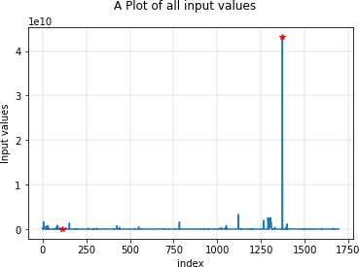
05/12/2020
Block Chain Project
Graphical Analysis using R base graphics
E xplore our R codes.

Slide 4
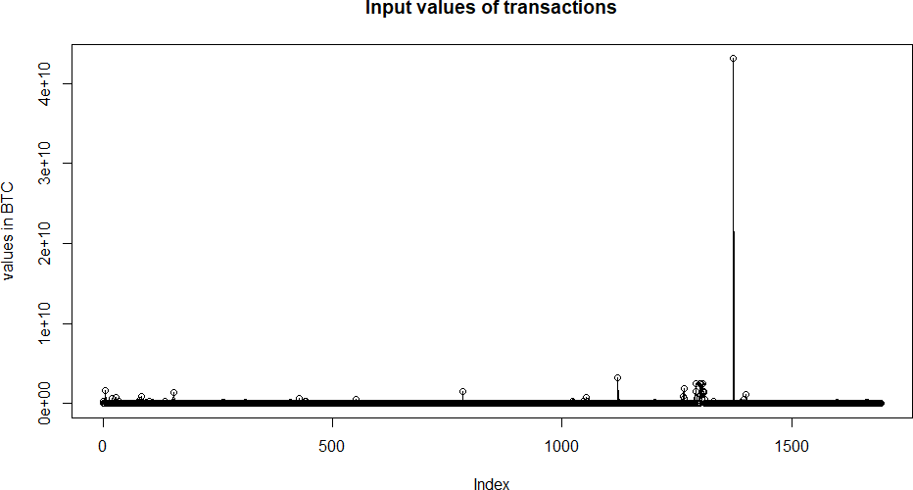
05/12/2020
Block Chain Project
Graphical Analysis with Matlab
P lay with our Mathworks codes

Slide 5
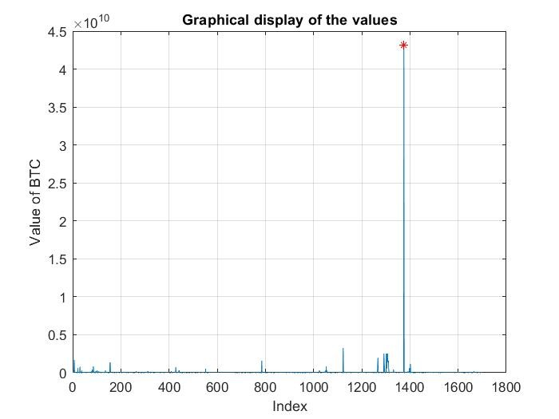
05/12/2020
Block Chain Project
Graphical Analysis using using Excel
Checkout the Execel workbook.

Slide 6
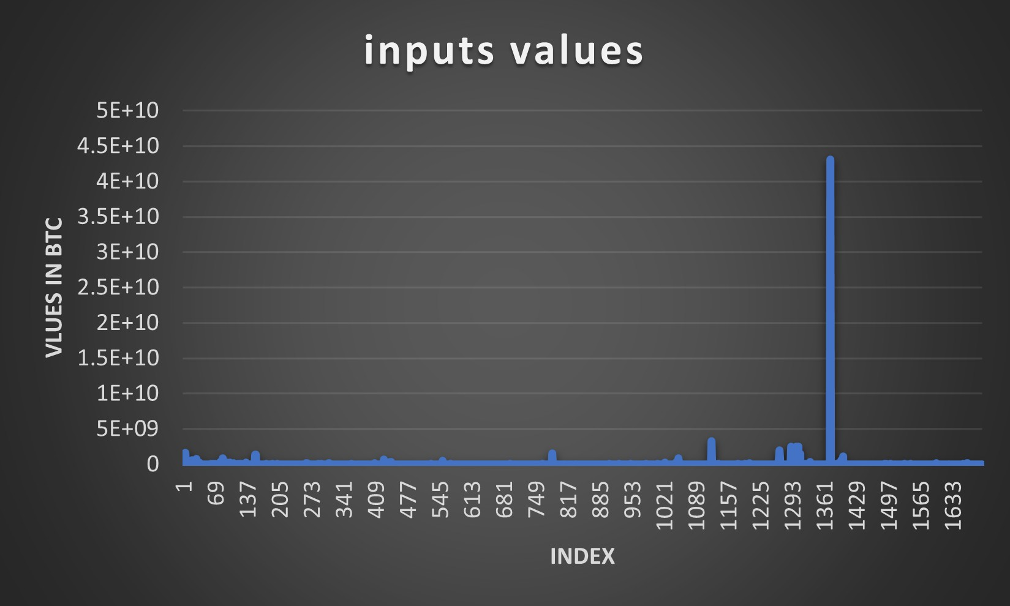
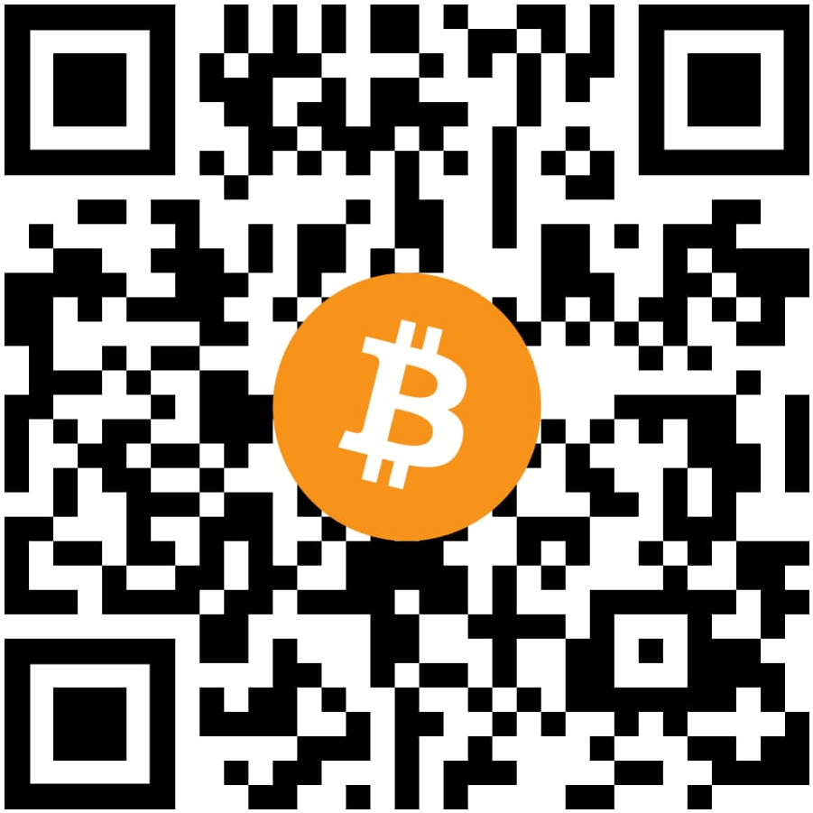
05/12/2020
Block Chain Project
Our Python Funcodes 💻
Don't be Scared of Python 🐍

